Slide 1
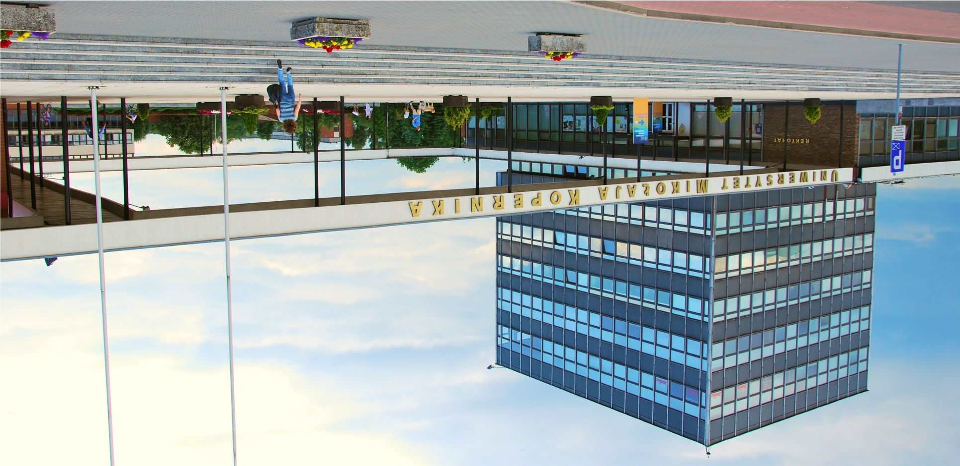










4th|
International Conference on Pollution Prevention and Clean Technologies
September 7 – 9, 2026
Abstract submission Deadline
July 15, 2026
Together we can create innovative and clean technologies to Environmental issues.
The goal of the conference is to improve the sharing of knowledge (on clean
technologies; energy sources/management;, carbon footprint; economic models and policies) at the international level, so that politicians, entrepreneurs and other stakeholders are aware of hidden threats
and new opportunities in the field of
environmental technologies.
Supporting Journals
Korean Journal of Chemical Engineering
Decarbon
Conference Tracks
Fuels and Energy
Sustainable Environment
Green Engineering
Circular Economy
Green Social Impact
AI Ecosystem
Venue
Jurija Gagarina 11, 87-100 Toruń, Poland
icppct2021@gmail.com
https://icppct.com/

